Slide 1
Oracle SQL

Slide 2
Types of Database Languages
Oracle SQL/ PL/SQL
T-SQL – Microsoft SQL Server
MySQL
Watcom-SQL etc.

Slide 3
Types of SQL Statements
DDL – Data Definition Language; commands that define structures in a database. Ex: CREATE, ALTER and DROP schema objects
  CREATE TABLE table_name (column_name1 data_type(size) , column_name2 data_type (size))
DML – Data Manipulation Language; commands that access and manipulate data in existing schema objects. Ex: SELECT, UPDATE, DELETE etc.
  SELECT column_name1, column_name2 from table_name
TCL – Transaction Control Language; commands that manage changes made by DML statements Ex: COMMIT, ROLLBACK
  Ex: DELETE from table_name WHERE column_name1 = some_value
    ROLLBACK;

Slide 4
Oracle
Products and services
  Oracle ERP (Enterprise Resource Planning) – It is a comprehensive suite of integration, global business applications, also known as E-Business Suite Examples of applications – Customer Relationship Management, Service Management, Financial Management, Human Capital Management, Project Portfolio Management, Advanced Procurement, Supply Chain Management, Value Chain Planning etc.
  Oracle SQL/ PL/SQL – Oracle’s procedural extension to industry standard SQL. PL/SQL program units are compiled by the Oracle database server and are stored inside the database. Ex: procedures and packages
  Oracle Database
Notes:
My background on how I started working with Oracle
Why know how to code and work as functional analyst
Examples of organizations that use Oracle
Career path for a business systems analyst in Oracle

Slide 5
Uses of Oracle PL/SQL
  Query database from applications
  Reporting
  Automation
  B2B/ A2A Integrations
  Build Application Program Interface (API)
  Date Integrity: Data conversion and validation

Slide 6
High level differences between Microsoft SQL Server and Oracle
 | Microsoft SQL Server | Oracle
Language | Transact SQL (T-SQL) | PL/SQL
Transaction Control A transaction can be defined as a group of operations or tasks that should be treated as a single unit. For instance, a collection of SQL queries modifying records that all must be updated at the same time, where (for instance) a failure to update any single records among the set should result in none of the records being updated | will execute and commit each command/task individually. | When a series of SQL queries that modify records have to be run as a group, oracle SQL makes changes in memory only until a COMMIT command is issued. After the commit, the next command issued is treated as a new transaction and the process begins again
Organization of DB objects | Organizes objects such as tables, views and procedures by database names (DBO). Users are assigned to a login which is granted access to a specific database and it’s objects | Database objects are grouped by schemas and all database objects can be shared among schemas and users. The access is limited to certain schemas and tables via roles and permissions Ex: GRANT SELECT ON OWNING_SCHEMA.OBJECT_NAME TO SCHEMA_1

Slide 7
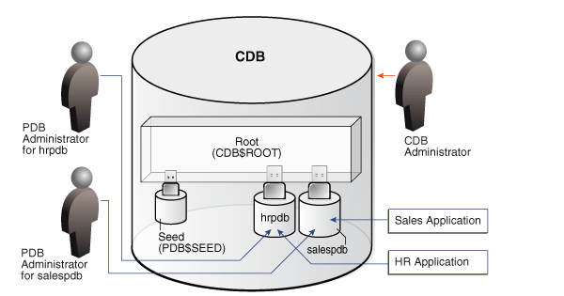
Oracle Pluggable Databases
CDB – Container Database; PDB – Pluggable Database
The Root stores oracle-supplied metadata (PL/SQL packages) and common users (database user known in every container.
Seed is a system supplied template that CDB can use to create new PDBs.

Slide 8
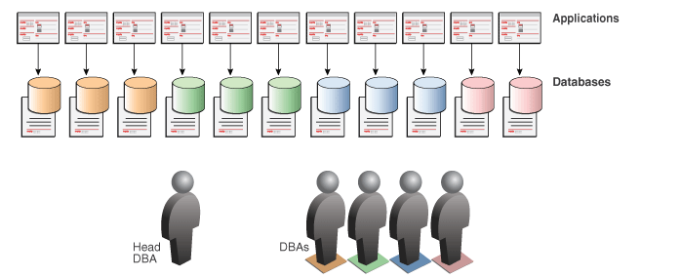
Oracle Pluggable Databases
Before Consolidation
Organizations may have hundreds or thousands of databases. These can run on multiple servers.
A database may only use a fraction of the server capacity (wasting the rest)
Context Switching between databases on a single server can result in wasted resources

Slide 9
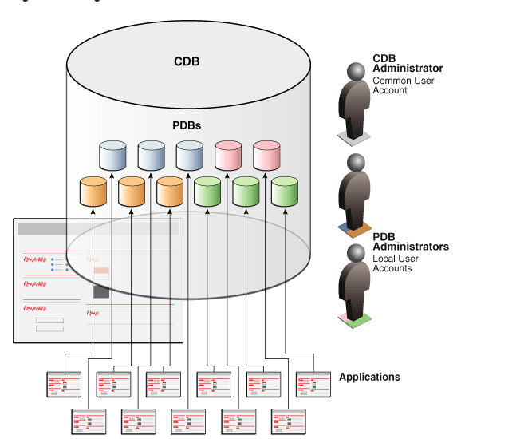
Oracle Pluggable Databases

Slide 10
High level differences between T-SQL and PL/SQL
T-SQL and PL/SQL have different syntax. The main difference is how they handle variables, stored procedures and built-in functions. PL/SQL can group procedures into packages.
Examples of built-in functions that are different
 | T-SQL | Oracle SQL
Current date/ time | GETDATE | SYSDATE
Length | LEN() | LENGTH()
Date Type Conversion | CONVERT(data type, expression, [format]) | TO_CHAR, TO_NUMBER, TO_DATE
Null Value | ISNULL(variable, new_value) | NVL(variable, new_value)

Slide 11
Oracle SQL – Basic Concepts
Datatype – The datatype of a value associates a fixed set of properties with the value.
    Ex: You can add values of datatype number but you can’t add values of datatype character
    Every column in a table needs to have a datatype assigned. All arguments used in a function or procedure should have as datatype assigned.
    Examples of oracle built-in data types –
    VARCHAR2 (size) – variable length character string. Maximum size is 4000 characters and minimum is 1 character.
    CHAR (size) – Fixed length character strings. Maximum size is 2000 characters and minimum is 1 character
    DATE - Valid date range from January 1, 4712 BC to December 31, 9999 AD. The default format is determined explicitly by the NLS_DATE_FORMAT parameter or implicitly by the NLS_TERRITORY parameter

Slide 12
NULL Values
    If a column in a row has no value then it is said to be NULL.
    A NVL function can be used to a return a value when a NULL value is encountered. Ex: NVL(commission, ‘No Commission’) -> will return ‘No Commission’ every time there is a NULL value encountered in the commission column.
    Most aggregate functions ignore NULL. Ex: A query that averages five values 100, null, null, 200, null will calculate the average to be (100 + 200)/2 = 150
    To test for nulls, use IS NULL or IS NOT NULL in conditions. For Ex, if you want to return the names of all sales persons whose commission is NULL then the query should be written something like this – SELECT sales_person from car_sales WHERE commission is NULL.

Slide 13
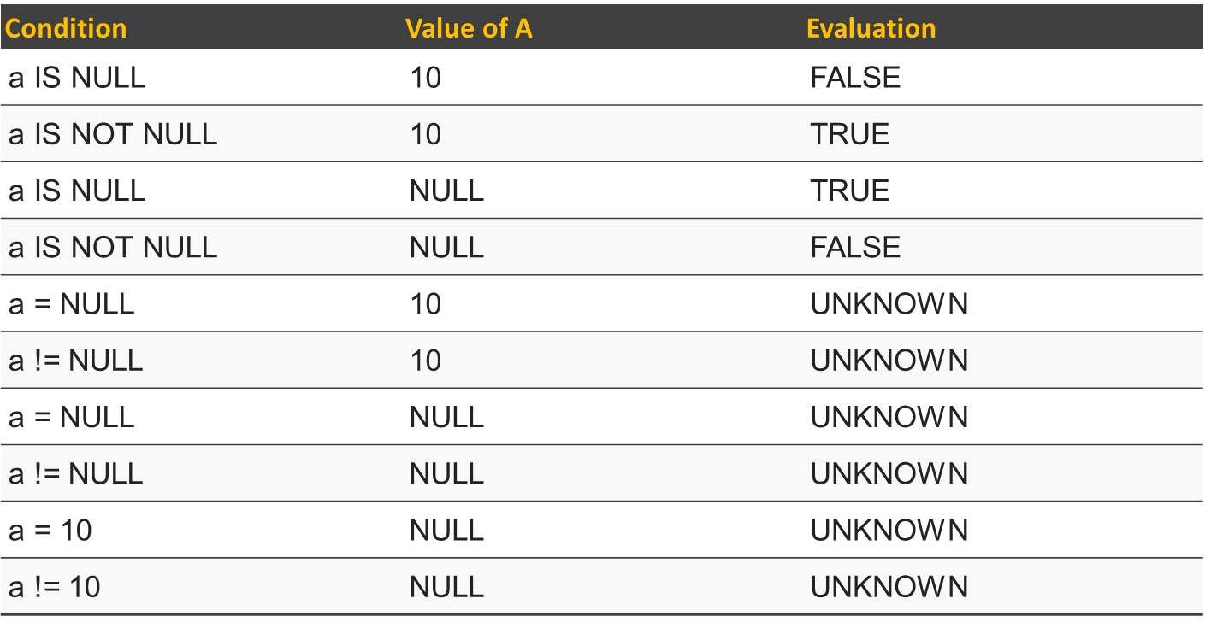
NULL Values

Slide 14
Literals
Text Literals – same as constant value and refers to a fixed data value.
  Text literals are enclosed in quotation marks so oracle can distinguish them from object and schema names.
  Examples: ‘CoderGirl’, ‘File_1.xlsx’, ‘Ashwina’’s laptop’
  Numeric Literals – used to specify fixed and floating-point numbers.
    + or – is a positive or negative values
    Digits – 0, 1,2,3,4,5 6,7,8,9
    E or e indicates scientific exponential notation
    F or f indicates binary floating point number (of type binary_float)
    D or d indicates binary floating point number (of type binary_double)
    Examples: 25, 0.4, +5.62, 25f, 0.5d, 25e-03

Slide 15
Format Model
    A character literal that describes the format of datetime or numeric data stored in a character string.
    The format for Oracle to use to return a value from the database
    The format for a value you have specified for Oracle to store in the database
    Examples:
    The datetime format model for the string ‘13: 23: 10’ is ‘HH24:MI:SS’
    The datetime format model for the string ’19-OCT-2016’ is ‘DD-Mon-YYYY’
    The number format for the string ‘$1,000.24’ is ‘$9,999.99’

Slide 16
Comments
A comment in the creation of an object can describe the purpose of that object.
Comments can be included in two ways
  Begin the comment with a slash and an asterisk (/*), enter the text for comments and end with an asterisk and a slash (*/)
  Begin the comment with two hyphens (--)

Slide 17
Database Objects
  Oracle database recognizes objects that are associated with a particular schema and objects that are not associated with a particular schema
  Schema Objects – A collection of logical structures of data. Schema objects can be created and manipulated with SQL
  Non Schema Objects – These objects are not contained in a schema but also can created and manipulated with SQL

Slide 18
Database Objects
  Schema Objects
    Clusters
    Constraints
    Database links
    Database triggers
    Dimensions
    External procedure libraries
    Index-organized tables
    Indexes
    Indextypes
    Java classes, Java resources, Java sources
    Materialized views
    Materialized view logs
    Object tables
    Object types
    Object views
    Operators
    Packages
    Sequences
    Stored functions, stored procedures
    Synonyms
    Tables
    Views

Slide 19
Database Objects
Non schema objects
  Contexts
  Directories
  Parameter Files
  Profiles
  Roles
  Rollback Segments
  Tablespaces
  Users

Slide 20
Examples of Built-in Functions
  TO_CHAR(VALUE, [,FORMAT_MASK])
  select sysdate FROM dual
  select to_char(sysdate, 'YYYY/MM/DD') from dual
  select to_char (sysdate, 'YEAR/MONTH/DAY') from dual
  select (1234) from dual
  select to_char(1234, '$9,999.00') from dual
  select to_char(1234, '9999.00') from dual
  COUNT() – returns the number of rows that matches a specified criteria
  SELECT COUNT(column_name) from table_name
  MAX() – returns the largest value of the selected column
  SELECT MAX(column_name) from table_name
  ROUND() – will round a numeric field to the number of decimals specified
  SELECT ROUND(column_name, decimals) from table_name
  UPPER() – converts the specified string to uppercase
  LOWER() – converts the specified string to lowercase
  INITCAP() – returns the first letter of each word in uppercase
  TRUNC(SYSDATE) – returns the current date with no timestamp

Slide 21
Resources
http://www.w3schools.com/
http://stevenfeuersteinonplsql.blogspot.com/
https://docs.oracle.com/cd/E10405_01/appdev.120/e10379/ss_oracle_compared.htm
Oracle SQL Developer – Integrated development environment for working with SQL in Oracle Databases (provided for free by Oracle)

