Slide 1
What is business intelligence?
Kathi Kellenberger
For Coder Girl SQL Group

Slide 2
Definition From Wikipedia
Business intelligence (BI) is the set of techniques and tools for the transformation of raw data into meaningful and useful information for business analysis purposes. BI technologies are capable of handling large amounts of unstructured data to help identify, develop and otherwise create new strategic business opportunities. The goal of BI is to allow for the easy interpretation of these large volumes of data. Identifying new opportunities and implementing an effective strategy based on insights can provide businesses with a competitive market advantage and long-term stability.^{[1]}

Slide 3
Components of bi
Data
  Operational data
  Data on the web
  Subscription – Azure Marketplace, Dun and Bradstreet
  Master data management
Data Warehouse
Cubes
Reports
Dashboards
Self-service BI
Data mining – Predictive analytics
Mobile solutions

Slide 4
Job opportunities in BI
Report writers
ETL developers – Extract, transform, load
Cube developers
  Analysis Services
  Business Objects
Big Data engineer
Data scientists
SharePoint developers and administrators

Slide 5
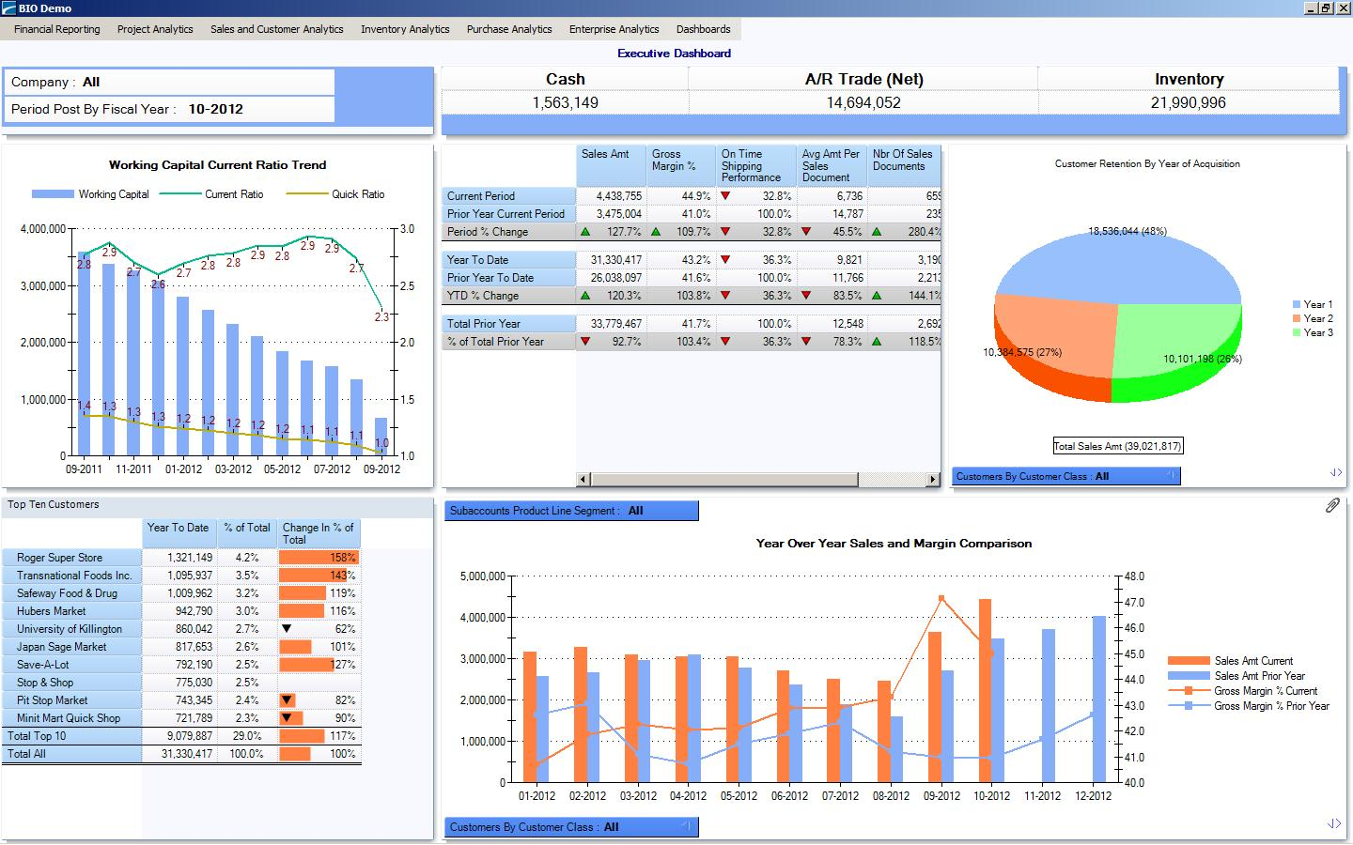
Dashboards
Link

Slide 6
Tools used in the Microsoft BI Stack
Excel
  Power Query
  Power Pivot
  Power View
SQL Server Reporting Services (SSRS)
SQL Server Integration Services (SSIS)
SQL Server Analysis Services (SSAS)
  Multidimensional
  Tabular
SharePoint
Power BI Dashboard
HD Insight

Slide 7
Power bi demo from Microsoft
https://youtu.be/OzjpSl8ugeM

